Slide 1

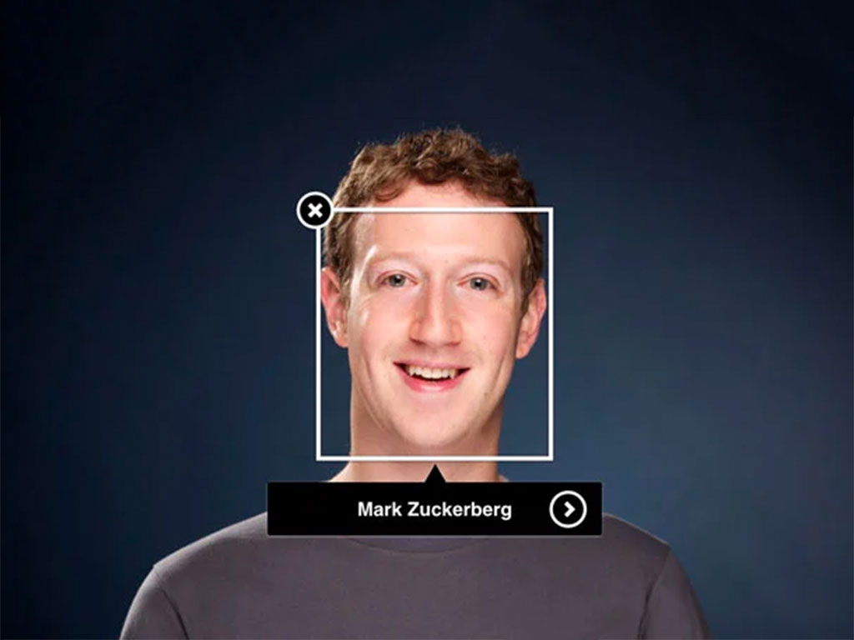
Facebook’s “New” Face Recognition Features
A review of Gizmodo article written by Sidney Fussell
By Romeo Jabbour
Notes:
Facebook = Being Seen
Feature launched in 2018
Let’s start with how this was communicated to users

Slide 2
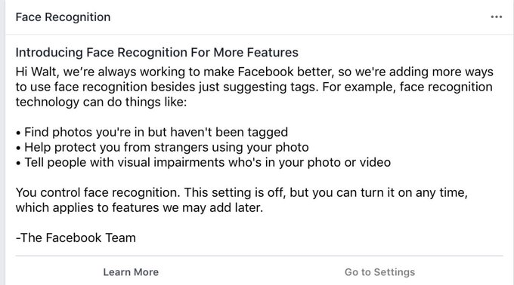
Notes:
Examples of their latest technology
Explore the points
Emphasis on the FR setting control

Slide 3
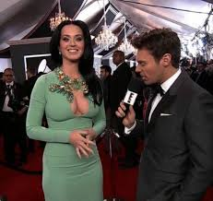
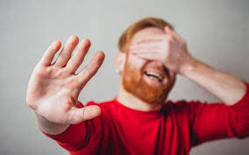
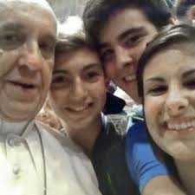
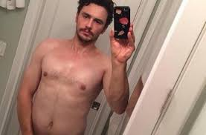
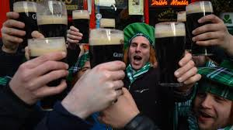
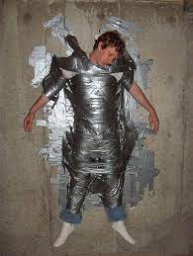
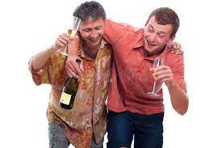
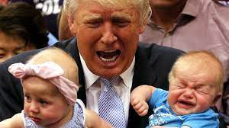
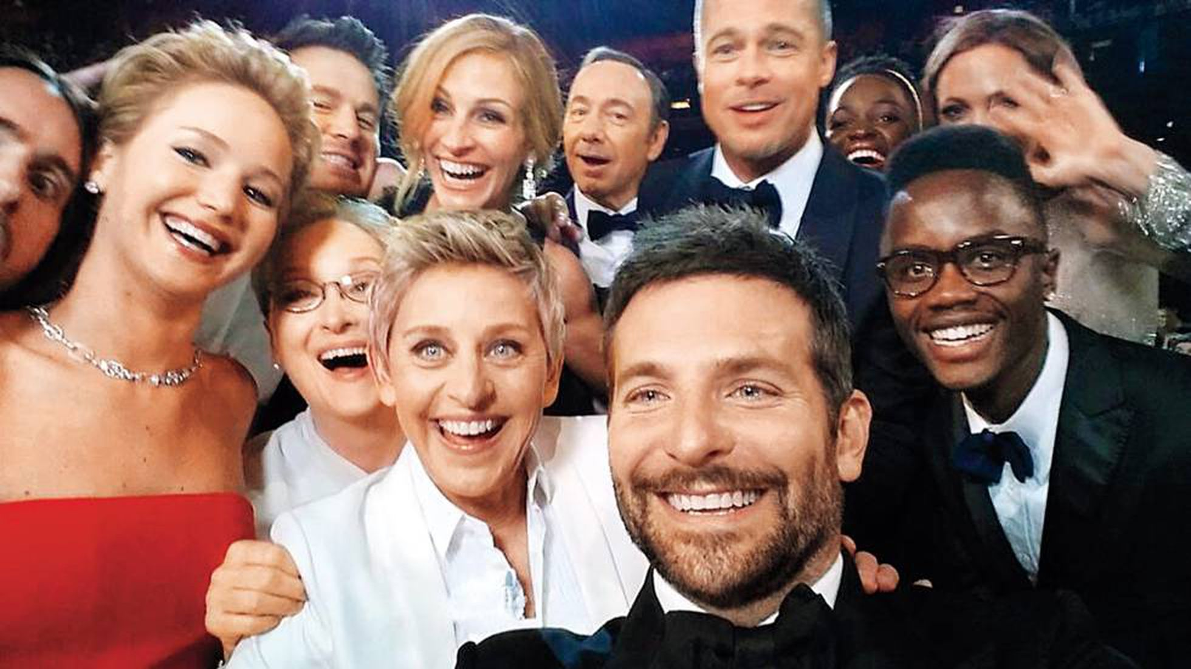
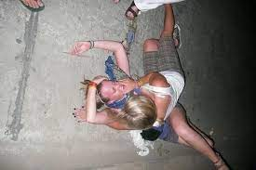
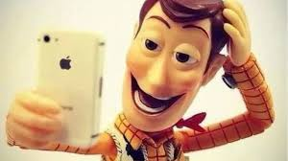
Find photos you’re in but haven’t been tagged
Notes:
Pros:
Image1: A friend of a friend
Image2: Memory lane
Image3: Friends phone selfie
Image 4: Oscar selfie Bradley Cooper -> let me in on it -> what is Spacey up to back there?
Cons:
Image5: Some selfies should stay off the internet. Drunken selfie: best body
Image6: Unflattering photos
Image7&8: Bad timing
It’s safe to say that this technology has it’s drawbacks

Slide 4
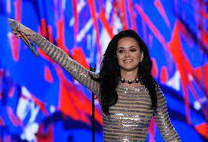
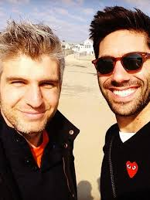
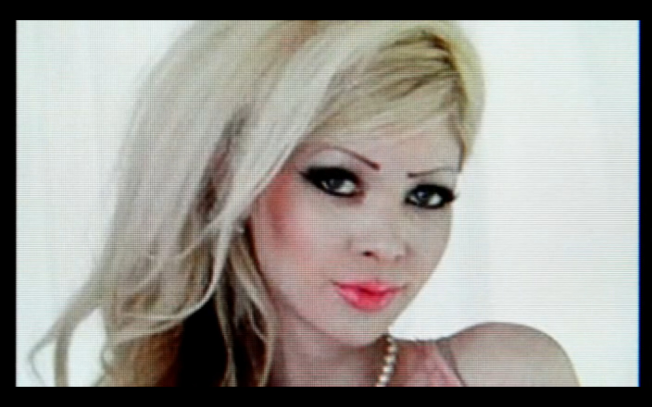


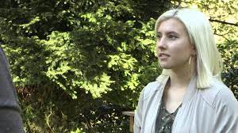
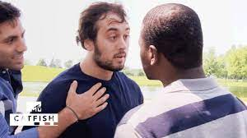
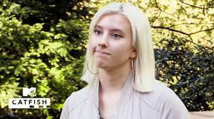
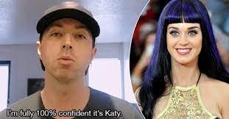
Help protect you from strangers using your photos
Notes:
This one is fantastic -> find your fake profiles
Katy Perry: Some catfishes are obvious
Lady is a Man: Some are not that obvious
GIF on Catfished: Realisation, Priceless (MasterCard)

Slide 5
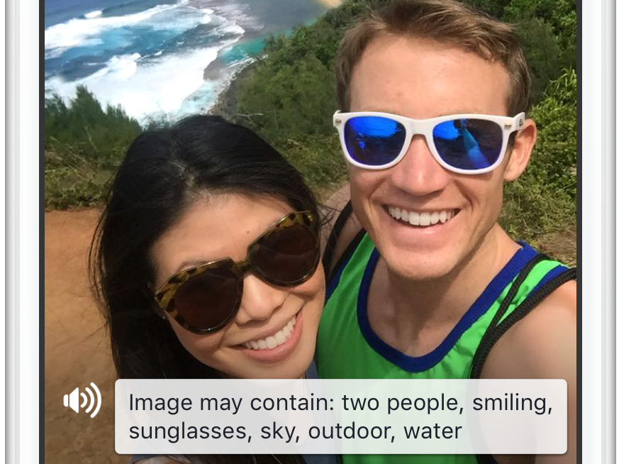

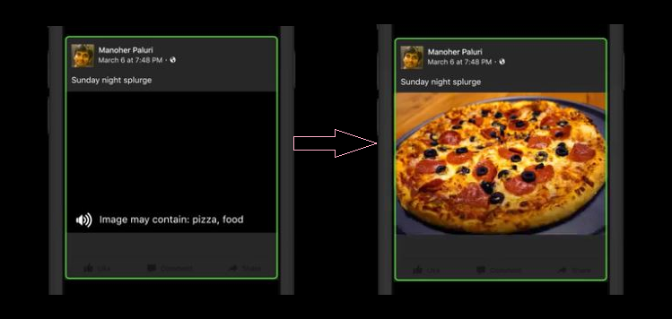
Tell people with visual impairments who’s in your photo or video
March 2016: in-person interviews of blind users
Notes:
Went out on a limb to Identify the challenges for people with low vision or blindness to consume their visual content, which can make this specific group of people feel isolated and even frustrated as they can’t fully engage with the interaction around these visual contents
March: to understand their everyday experiences on FB. Along with a previous study,
This group of people comment and like photos as often as people who did not have visual impairments, though they create and share slightly fewer photos than the average Facebook user
By focusing on the experience of taking and posting photos and videos, interpreting visual content, and responding to visual content. These findings, have informed their new AI-powered automatic alternative (alt) text to better caption visual content on Facebook.

Slide 6
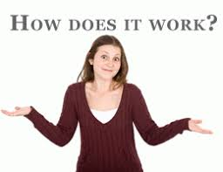
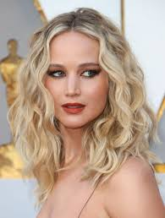
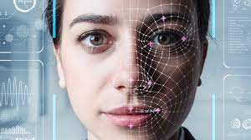
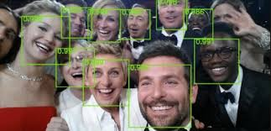
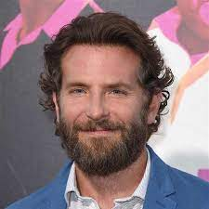
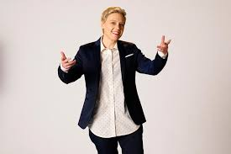
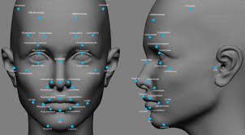
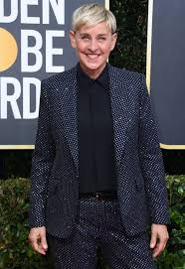
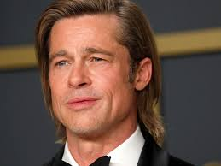
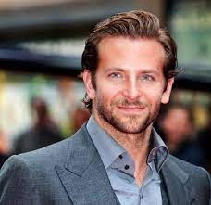
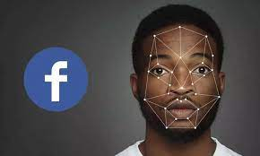
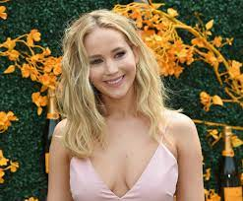
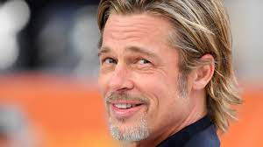
Tag Suggestions
Face Recognition
Notes:
“tag suggestions” or “face recognition” turned on
FaceMap Images: the platform’s machine learning systems analyse the pixels of the face in the image, creating what’s called a “template.”
Matrix:They describe the template as a “string of numbers,”
Celeb Collage: Unique template -> new photos -> faces present in the image to existing templates
Oscar’s selfie: suggests a tag if there’s a match.

Slide 7
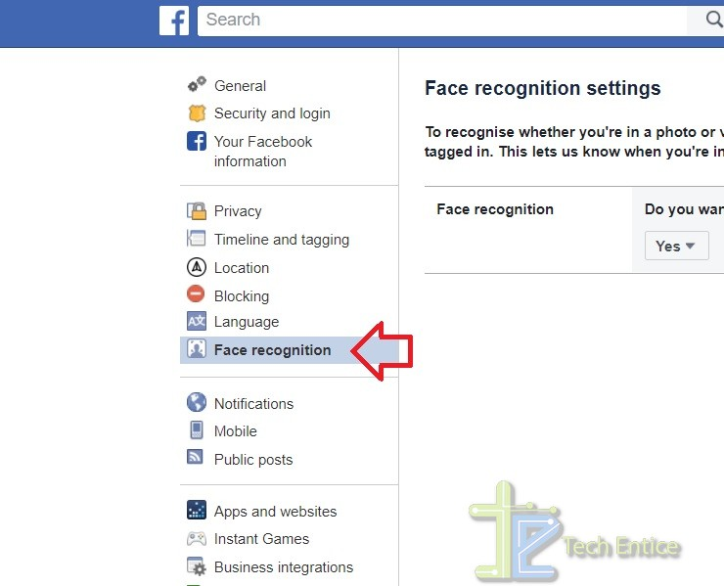
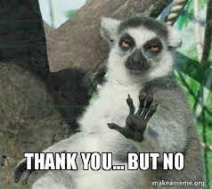


Notes:
Opt Out
If tag suggestions turned off, FR is off
Opt In
Tag suggestions on / set to friend, face recognition is on.
setting isn’t truly OFF by default

Slide 8
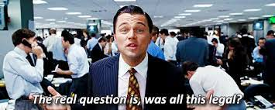
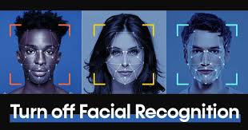
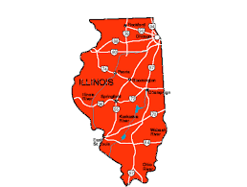
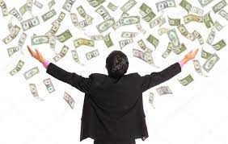
Biometric Information Privacy Act
Notes:
Legal?
BioData precious -> Protect it
Sueing:
Illinois’ BIPA -> Collection of face data violates BIPA -> FB retaliated -> does no harm -> Throw out case -> Settled: 650mil for 1.42mil ppl
2021 -> bye bye FB FR entirely

Slide 9
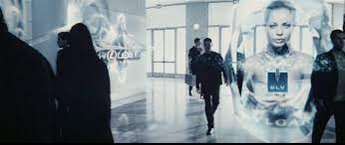
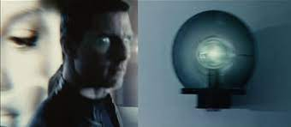
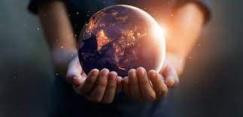
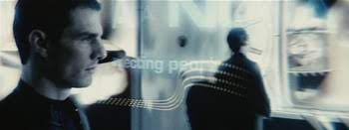
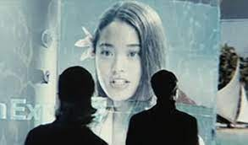
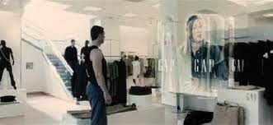
What is the future for the human race?
Notes:
Human Future?
Face unlock phones
Pay with just a smile
Minority Report: personalized ads
And who would be best fit to govern our BioInfo?

Slide 10


